Slide 1
chapter 14
Files and Exceptions II

Slide 2
What we already know
Files are bytes on disk. Two types, text and binary (we are working with text)
open creates a connection between the disk contents and the program
different modes of opening a file, 'r', 'w', 'a'
files might have different encodings (default is utf_8)

Slide 3
more of what we know
all access, reading or writing, to a text file is by the use of strings
iteration via a for loop gathers info from a file opened for reading one line at a time
we write to a file opened for reading using the print function with an argument file=

Slide 4
Code Listing 14.1
Review

Slide 6
results, searching for "This"

Slide 7
More ways to read
my_file.read()
Reads the entire contents of the file as a string and returns it. It can take an optional argument integer to limit the read to N bytes, that is my_file.read(N)
my_file.readline()
Delivers the next line as a string.
my_file.readlines() # note plural
Returns a single list of all the lines from the file

Slide 8
example file
We'll work with a file called temp.txt which has the following file contents
First Line
Second Line
Third Line
Fourth Line

Slide 12
More ways to write
Once opened, you can write to a file (if the mode is appropriate):
my_file.write(s)
Writes the string s to the file
my_file.writelines(lst)
write a list of strings (one at a time) to the file

Slide 14
Universal New Line

Slide 15
Different OS's, different format
Each operating system (Windows, OS X, Linux) developed certain standards for representing text
In particular, they chose different ways to represent the end of a file, the end of a line, etc.

Slide 16
Universal new line
To get around this, Python provides by default a special file option to deal with variations of OS text encoding called Universal new line
you can over-ride this with an option to open called newline=
look at the docs for what this entails.

Slide 17
Working with a file

Slide 18
The current file position
Every file maintains a current file position.
It is the current position in the file, and indicates what the file will read next
Is set by the mode table above

Slide 19
Remember the file object buffer
When the disk file is opened, the contents of the file are copied into the buffer of the file object
Think of the file object as a very big list, where every index is one of the pieces of information of the file
The current position is the present index in that list

Slide 21
the tell() method
The tell() method tells you the current file position
The positions are in bytes (think characters for UTF-8) from the beginning of the file
my_file.tell() => 42L

Slide 22
the seek() method
the seek() method updates the current file position to a new file index (in bytes offset from the beginning of the file)
fd.seek(0) # to the beginning of the file
fd.seek(100) # 100 bytes from beginning

Slide 23
counting bytes is a pain
counting bytes is a pain
seek has an optional argument set:
0: count from the beginning
1: count for the current file position
2: count from the end (backwards)

Slide 24
every read moves current forward
every read/readline/readlines moves the current pos forward
when you hit the end, every read will just yield '' (empty string), since you are at the end
no indication of end-of-file this way!
you need to seek to the beginning to start again (or close and open, seek is easier)

Slide 26
with statement
open and close occur in pairs (or should) so Python provides a shortcut, the with statement
creates a context that includes an exit which is invoked automatically
for files, the exit is to close the file
with expression as variable:
suite

Slide 27
File is closed automatically when
the suite ends

Slide 28
read(size=1)
you can use the read() method to read just one byte at a time, and in combination with seek move around the file and “look for things”. Once current is set, you can begin reading again

Slide 29
More on CSV files

Slide 30
spreadsheets
The spreadsheet is a very popular, and powerful, application for manipulating data
Its popularity means there are many companies that provide their own version of the spreadsheet
It would be nice if those different versions could share their data

Slide 31
CSV, basic sharing
A basic approach to share data is the comma separated value (CSV) format
it is a text format, accessible to all apps
each line (even if blank) is a row
in each row, each value is separated from the others by a comma (even if it is blank)
cannot capture complex things like formula

Slide 32
Spread sheet and corresponding CSV file

Slide 33
Even CSV isn't universal
As simple as that sounds, even CSV format is not completely universal
different apps have small variations
Python provides a module to deal with these variations called the csv module
This module allows you to read spreadsheet info into your program

Slide 34
csv reader
import the csv module
open the file as normally, creating a file object.
create an instance of a csv reader, used to iterate through the file just opened
you provide the file object as an argument to the constructor
iterating with the reader object yields a row as a list of strings

Slide 35
Code Listing 14.2 (and output)

Slide 37
things to note
Universal new line is working by default
needed for this worksheet
A blank line in the CSV shows up as an empty list
empty column shows up as an empty string in the list

Slide 38
csv writer
much the same, except:
the opened file must have write enabled
the method is writerow, and it takes a list of strings to be written as a row

Slide 39
Code Listing 14.3
This code listing is a good example of reading, modifying and then writing out a CSV file that could be read by a spreadsheet
It involves lots of slicing (and has comments) so it is a good exercise

Slide 40
os module

Slide 41
What is the os module
The os module in Python is an interface between the operating system and the Python language.
As such, it has many sub-functionalities dealing with various aspects.
We will look mostly at the file related stuff

Slide 42
What is a directory/folder?
Whether in Windows, Linux or on OS X, all OS's maintain a directory structure.
A directory is a container of files or other directories
These directories are arranged in a hierarchy or tree
remember hierarchy from chapter 12

Slide 43
Computer Science tree
it has a root node, with branch nodes, ends in leaf nodes
the directory structure is hierarchy (tree)

Slide 44
Directory tree
Directories can be organized in a hierarchy, with the root directory and subsequent branch and leaf directories
Each directory can hold files or other directories
This allows for sub and super directories
just like in subclass/superclass in chapter 12

Slide 45
file path is a path through the tree
A path to a file is a path through the hierarchy to the node that contains a file
/bill/python/code/myCode.py
path is from the root node /, to the bill directory, to the python directory, to the code directory where the file myCode.py resides

Slide 46
the / in a path
think of / as an operator, showing something is a directory
follow the path, the leaf is either a directory or file
/
/bill
/fred
/python
/code

Slide 47
a path String
a valid path string for python is a string which indicates a valid path in the directory structure
Thus '/Users/bill/python/code.py' is a valid path string

Slide 48
different 'paths' for different os
It turns out that each OS has its own way of specifying a path
C:\bill\python\myFile.py
/Users/bill/python/myFile.py
Nicely, Python knows that and translates to the appropriate OS

Slide 49
Two special directory names
The directory name '.' is shortcut for the name of the current directory you are in as you traverse the directory tree
The directory name '..' is a shortcut for the name of the parent directory of the current directory you are in

Slide 50
Some os commands
os.getcwd() Returns the full path of the current working directory
os.chdir(path_str) Change the current directory to the path provided
os.listdir(path_str) Return a list of the files and directories in the path (including '.')

Slide 52
Some more os commands
os.rename(source_path_str, dest_path_str) Renames a file or directory
os.mkdir(path_str) make a new directory. So os.mkdir('/Users/bill/python/new') creates the directory new under the directory python.
os.remove(path_str)Removes the file
os.rmdir(path_str) Removes the directory, but the directory must be empty

Slide 53
the walk function
os.walk(path_str) Starts at the directory in path_str. It yields three values:
dir_name, name of the current directory
dir_list, list of subdirectories in the directory
files, list of files in the directory
If you iterate through, walk will visit every directory in the tree. Default is top down

Slide 54
Walk example

Slide 55
os.path module

Slide 56
os.path module
allows you to gather some info on a path's existence
os.path.isfile(path_str) is this a path to an existing file (T/F)
os.path.isdir(path_str) is this a path to an existing directory (T/F)
os.path.exists(path_str) the path (either as a file or directory) exists (T/F)

Slide 57
os.path names
assume p = '/Users/bill/python/myFile.py'
os.path.basename(p) returns 'myFile.py'
os.path.dirname(p) returns '/Users/bill/python'
os.path.split(p) returns ['Users/bill/python','myFile.py']
os.path.splitext(p) returns '/Users/bill/python/myFile', '.py'
os.path.join(os.path.split(p)[0],'other.py') returns '/Users/bill/python/other.py'

Slide 58
Code Listing 14.4

Slide 59
Utility to find strings in files
The main point of this function is to look through all the files in a directory structure and see if a particular string exists in any of those files
Pretty useful for mining a set of files
lots of comments so you can follow

Slide 61
More Exceptions

Slide 62
What we already know
try-except suite to catch errors:
try:
suite to watch
except ParticularError
error suite

Slide 63
more of what we know
try suite contains code that we want to watch:
if an error occurs the try suite stops and looks for an except suite that can handle the error
except suite has a particular error it can handle and a suite of code for handling that error

Slide 64
Error Flow

Slide 65
Code Listing 14.5

Slide 67
continuing

Slide 68
Check for specific exceptions
Turns out that you don’t have to check for an exception type. You can just have an exception without an particular error and it will catch anything
That is a bad idea. How can you fix (or recover from) an error if you don’t know the kind of exception
Label your exceptions, all that you expect!

Slide 69
What exceptions are there?
In the present Python, there is a set of exceptions that are pre-labeled.
To find the exception for a case you are interested it, easy enough to try it in the interpreter and see what comes up
The interpreter tells you what the exception is for that case.

Slide 70
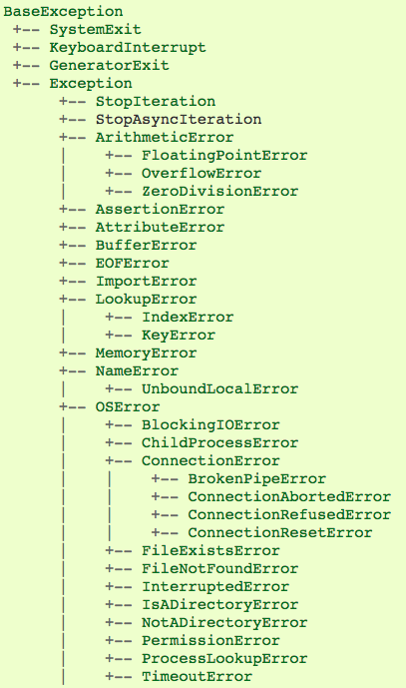
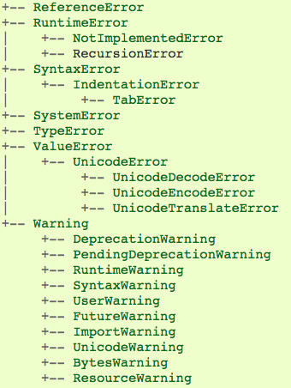
From Python docs
webpage

Slide 71
Examples
In [1]: 1/0Out [1]:
Traceback (most recent call last): File "<pyshell#9>", line 1, in <module> 1/0
ZeroDivisionError: integer division or modulo by zero
In [2]: open("junk")
Out [2]: Traceback (most recent call last): File "<stdin>", line 1, in <module>
FileNotFoundError: [Errno 2] No such file or directory: 'junk'
error
names
CAPS
matter!

Slide 72
Philosophy of Exception Handling

Slide 73
Dealing with problems
Two ways to deal with exceptions
LBYL: Look Before you Leap
EAFP: Easier to Ask Forgiveness than Permission (famous quote by Grace Hopper)

Slide 74
Look Before You Leap
By this we mean that before we execute a statement, we check all aspects to make sure it executes correctly:
if it requires a string, check that
if it requires a dictionary key, check that
Tends to make code messy. The heart of the code (what you want it to do) is hidden by all the checking.

Slide 75
Easier to Ask Forgiveness than Permission
By this we mean, run any statement you want, no checking required
However, be ready to “clean up any messes” by catching errors that occur
The try suite code reflects what you want to do and the except code what you want to do on error. Cleaner separation!

Slide 76
Python likes EAFP
Code Python programmers support the EAFP approach:
run the code, let the except suites deal with the errors. Don’t check first.

Slide 77
Code Listing 14-6

Slide 79
Extensions to the basic Exception Model

Slide 80
Version 2, finally suite
you can add a finally suite at the end of the try/except group
the finally suite is run as you exit the try/except suite, no matter whether an error occurred or not.
even if an exception raised in the try suite was not handled!
Gives you an opportunity to clean up as you exit the try/except group

Slide 81
finally and with
finally is related to a with statement:
creates a context (the try suite)
has an exit, namely execute the finally suite

Slide 82
Version 3, else
One way to think about things is to think of the try as a kind of condition (an exception condition) and the excepts as conditional clauses
if an exception occurs then you match the exception
the else clause covers the non-exception condition. It runs when the try suite does not encounter an error.

Slide 83
The whole thing
try:
code to try
except PythonError1:
exception code
except PythonError2:
exception code
except:
default except code
else:
non exception case
finally:
clean up code

Slide 84
Code Listing 14-7

Slide 86
Raising and creating your own exceptions

Slide 87
invoking yourself, raise
You can also choose to invoke the exception system anytime you like with the raise command
raise MyException
you can check for odd conditions, raise them as an error, then catch them
they must be part of the existing exception hierarchy in Python

Slide 88
Non-local catch
Interestingly, the except suite does not have to be right next to the try suite.
In fact, the except that catches a try error can be in another function
Python maintains a chain of function invocations. If an error occurs in a function and it cannot catch it, it looks to the function that called it to catch it

Slide 89
Make your own exception
You can make your own exception.
Exceptions are classes, so you can make a new exception by making a new subclass:
class MyException (IOError):
pass
When you make a new class, you can add your own exceptions.

Slide 90
Code Listing 14.9
password manager

Slide 91
part 1

Slide 92
part 2

